Slide 1
Marks2CSV
A simple solution to convert tabular mark fields to CSV file
Mini Project Presentation: Second Review
Guided by:
Dr. Deepa V.
Presented by:
Ajay T Shaju, SJC20AD004
Emil Saj Abraham, SJC20AD028
Justin Thomas Jo, SJC20AD046
Vishnuprasad K G, SJC20AD063
Artificial Intelligence & Data Science Mini Project: ADD334 12th June 2023 1/25
Notes:
Work done after zeroth review

Slide 2
Outline
Introduction
Literature Survey
Problem Statement
Research Scope and Objectives
Application
Methodology
Data Collection
Block Diagram
Techniques
Results and Discussion
Conclusion and Future Scope
References
Artificial Intelligence & Data Science Mini Project: ADD334 12th June 2023 2/25

Slide 3
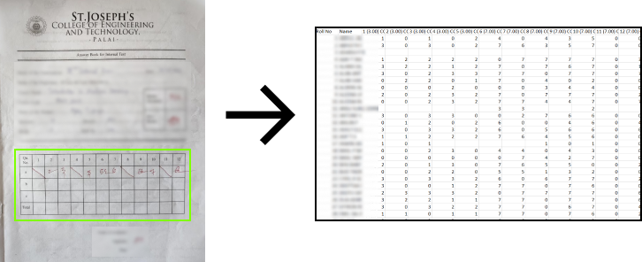
Introduction
Idea: Instant conversion of answer sheet data to CSV files.
Saves time with its fast performance.
Easy to use.
Artificial Intelligence & Data Science Mini Project: ADD334 12th June 2023 3/25
Notes:
●Save time and resources - resources in the sense, productivity of our teachers
●Reduce errors - To a great extend, bcz we used a NN trained on 1000s of image data

Slide 4
Literature Survey
OCR,artificial intelligence,document scanning,machine learning,image recognition.
Increased speed and efficiency, improved accuracy, reduced costs and increased accessibility.
Gap - recognition accuracy of complex data structures is poor.
Future scope - impact of OCR increases as technology advances, thereby giving more importance and emphasis to using it in businesses and organizations.
[1] A.Raj, S.Sharma, J.Singh, A.Singh, “Revolutionizing Data Entry: An In-Depth Study of Optical Character Recognition Technology and Its Future Potential”, International Journal for Research in Applied Science & Engineering Technology, Vol. 11 No.2, pp: 645-653, Feb 2023.
Artificial Intelligence & Data Science Mini Project: ADD334 12th June 2023 4/25
Notes:
.Improved characteristics for the model proposed.
Accuracy for simpler data structures are significantly satisfiable.

Slide 5
OCR classification and image processing with use of Naive Bayes algorithm.
Identification of text from handwritten documents, extracting features and training them.
Gap - accuracy is only 53%, lack of implementation of better model.
Future scope - apply same method with a neural network.
[2] Ömer Aydin, “Classification of Documents Extracted from Images with Optical Character Recognition Methods”, Anatolian Journal of Computer Sciences, Vol.6 No.2 pp:46-55, 01 Jun, 2021.
Artificial Intelligence & Data Science Mini Project: ADD334 12th June 2023 5/25
Notes:
Using Naive Bayes algorithm yields only under average accuracy.
Prefer neural network.

Slide 6
Image processing, OCR model, long short term memory.
Related work - text and image segmentation, CNN.
Gap - cannot identify text set at a particular angle.
Future scope - implies more usage of PyTesseract over SVM.
[3] Raajkumar G., Indumathi D., “Optical Character Recognition using Deep Neural Network”, International Journal of Computer Applications, Vol. 176 No. 41 pp:61-65, July 2020.
Artificial Intelligence & Data Science Mini Project: ADD334 12th June 2023 6/25
Notes:
If camera is not kept at said angle, the OCR tool could malfunction.
Pytesseract > SVM

Slide 7
Optical character recognition,classification,languages,feature extraction,deep learning.
Implementation of MLP, use of datasets like CEDAR,MNIST,CHARS74K.
Gap - Publicly available datasets also include stimuli that are aligned well with each other and fail to incorporate examples that correspond well with real-life scenarios, i.e. writing styles, distorted strokes, variable character,thickness and illumination.
Future scope - implementation of deep learning architectures like CNN,RNN and LSTM will steadily increase.
[4] J.Memon, R.Sami, Rizwan A.Khan, M.Uddin, “Handwritten Optical Character Recognition (OCR): A Comprehensive Systematic Literature Review (SLR)”, IEEE Access, Vol. 8, pp:142642-142668, 2020.
Artificial Intelligence & Data Science Mini Project: ADD334 12th June 2023 7/25
Notes:
MLP - Multilayer Perceptron.
Datasets - MNIST, CHARS74K
Different style of handwriting, distortion, thickness variation

Slide 8
Problem Statement
Manual data entry is a labor-intensive process that requires significant time and effort.
Loss of valuable time
Prone to errors
Inaccurate data
This project aims to develop an automated solution that streamlines the aforementioned problems.
Artificial Intelligence & Data Science Mini Project: ADD334 12th June 2023 8/25
Notes:
We know that man data entry is a tedious & Labor intensive process,
And it takes a lot of time to enter data manually, and it is the loss of valuable time.
And manual data entry is more prone to errors, which will result in inaccurate data.

Slide 9
Research Scope and Objectives
Scope:
Automated system to make CSV out of images of answer sheets.
Use neural networks to clearly classify the digits to attain optimal results.
To detect decimal marks during the OCR processing.
Train the model to detect marks as per customer requirements.
Create a smaller device to encase the tool.
Objective:
Create a tool to help teachers in data entry process.
Implementation of OCR using the CNN Architecture.
A customizable program to extract table marks with programmer’s control.
Artificial Intelligence & Data Science Mini Project: ADD334 12th June 2023 9/25
Notes:
Stress on CNN.
The project utlizes NN

Slide 10
Application
Detection of handwritten marks from images and their conversion to CSV format.
Simplify the mark entry process by avoiding manual input on each cell.
Final output obtained as CSV file comprising all numbers extracted from the input images.
Designed specifically for SJCET teachers.
Artificial Intelligence & Data Science Mini Project: ADD334 12th June 2023 10/25

Slide 11
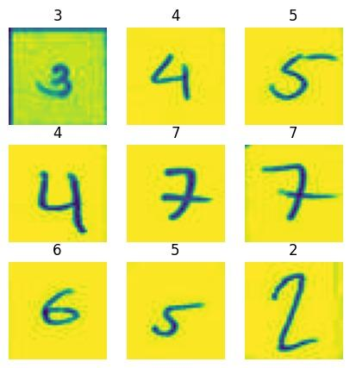
Methodology - Data Collection
Main data sources -
College answer sheets (7,420) and
Kaggle number dataset (13, 855)
Data Type - Image data of JPG format
Data Size - 40px x 40px x 3 channel
Data Storage -
Windows File System & Zip Formats
Training Set
Artificial Intelligence & Data Science Mini Project: ADD334 12th June 2023 11/25
Notes:
Our main data sources are our college answer sheets and kaggle number data set
the type of data is image data of jpeg format
each data point is of size 40 by 40 pixels and has three colour channels red, green and blue
we store the data in our local system and for ease of handling we have converted the data set to zip format too…
in the right side you can see the sample images of our training partition of our dataset and above all the images we have given the ground truth also…

Slide 12
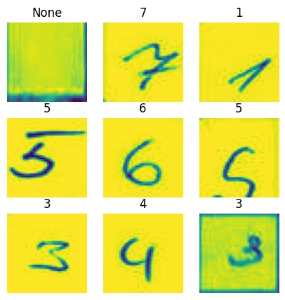
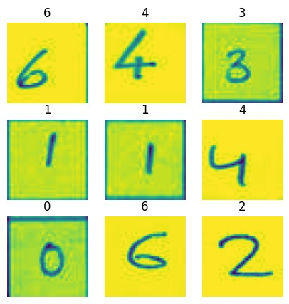
Validation Set
Testing Set
Artificial Intelligence & Data Science Mini Project: ADD334 12th June 2023 12/25

Slide 13
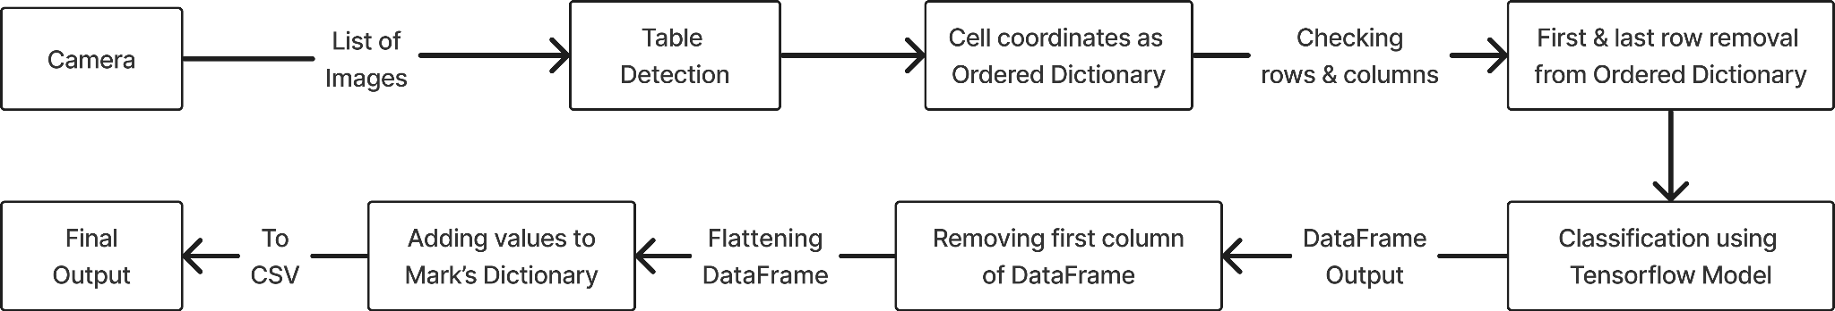
Methodology - Block Diagram
Our Work in 4 Steps
Working of System
Artificial Intelligence & Data Science Mini Project: ADD334 12th June 2023 13/25

Slide 14
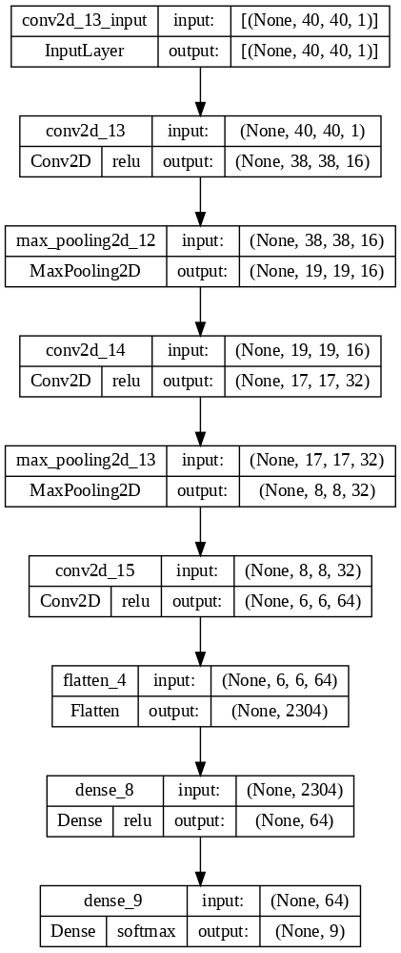
Neural Network Architecture
Artificial Intelligence & Data Science Mini Project: ADD334 12th June 2023 14/25
Notes:
2 Hidden layers – conv + max pooling
None is the batch size, it is 32 in our case but in keras it is defaults to None, so that we could have a flexibility in batch size
Didnt give new max pooling as it will reduce size than desired

Slide 15
Methodology - Techniques
Increased the speed of processing from 10 minutes to 3 minutes
PaddleOCR takes 10 minutes to complete whole process.
New processing is done on built-in data structure (ordered dictionary).
First & last row are removed by deleting the keys of ordered dictionary.
We run OCR only on remaining 39 cells.
Using custom trained OCR tool supported by a CNN architecture for classification.
Artificial Intelligence & Data Science Mini Project: ADD334 12th June 2023 15/25
Notes:
ANN Created, and presented as CNN.

Slide 16
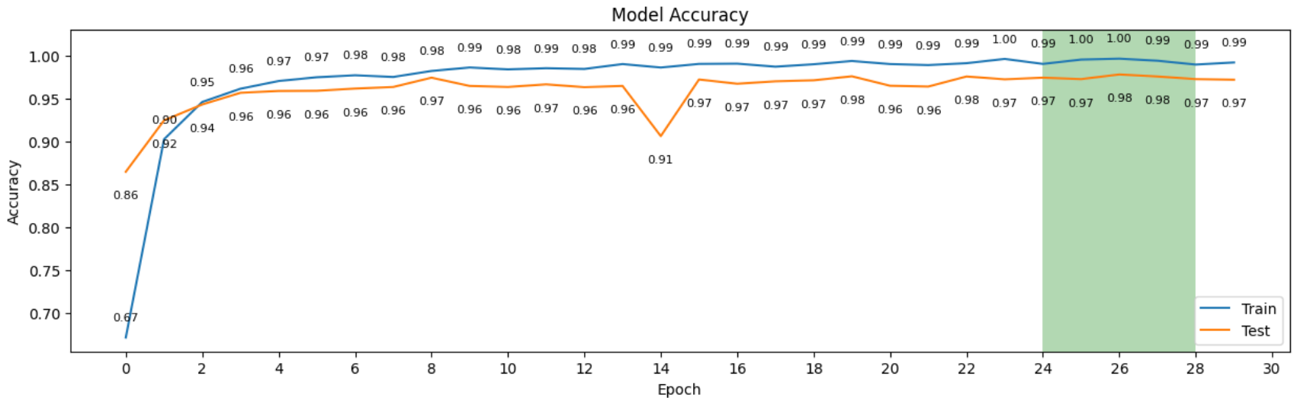
Results and Discussion
As epoch value increases, we see training and testing accuracies gradually increasing.
Model performs best when the epoch value is within the shaded region.
Model Accuracy vs Epoch
Artificial Intelligence & Data Science Mini Project: ADD334 12th June 2023 16/25

Slide 17
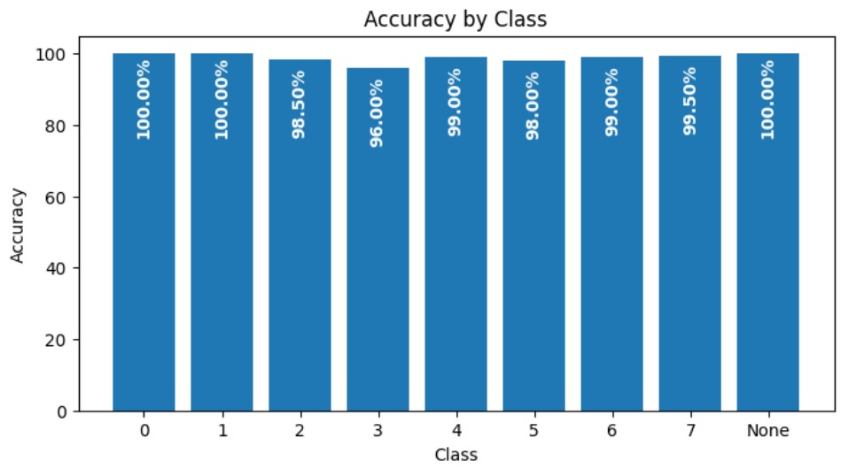
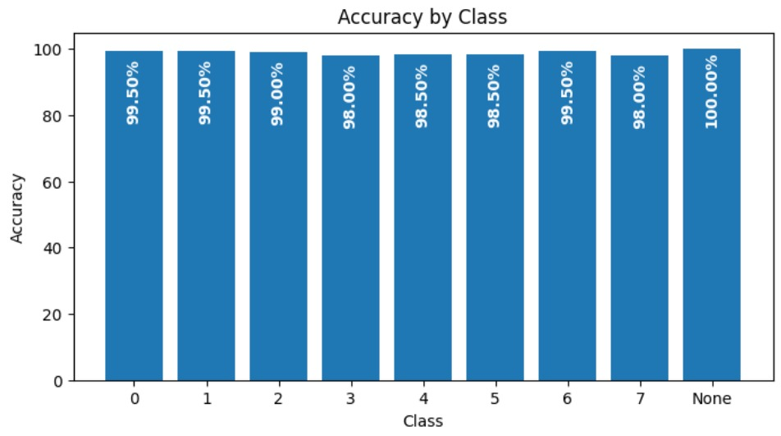
Accuracy by Class
CNN_Model_0
CNN_Model_1
Comparison of detection accuracy of each class for CNN_Model_0 and CNN_Model_1.
Accuracy values improve in CNN_Model_1 over values of CNN_Model_0.
Artificial Intelligence & Data Science Mini Project: ADD334 12th June 2023 17/25
Notes:
Accuracy % improves for certain classes compared to its values in the older model.

Slide 18
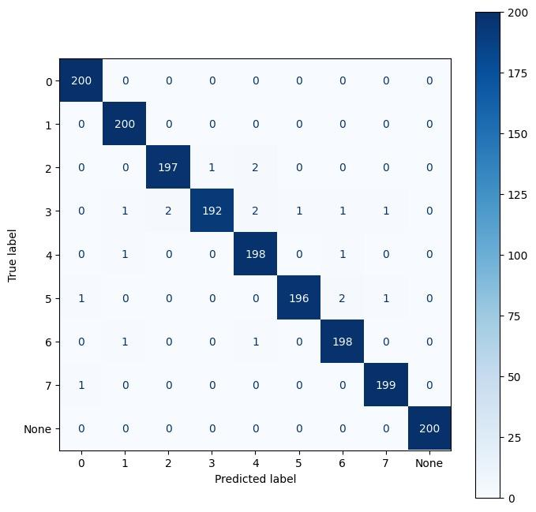

Comparison of Confusion Matrices
Notice the TP value changing for certain numbers in both CNN_Model_0 and CNN_Model_1.
CNN_Model_0
CNN_Model_1
Artificial Intelligence & Data Science Mini Project: ADD334 12th June 2023 18/25

Slide 19
Performance Evaluation
 | 0 | 1 | 2 | 3 | 4 | 5 | 6 | 7 | None
 | CNN_Model_0
Precision | 0.99 | 0.99 | 0.99 | 0.99 | 0.98 | 0.99 | 0.98 | 0.99 | 1.00
Recall | 1.00 | 1.00 | 0.98 | 0.96 | 0.99 | 0.98 | 0.99 | 0.99 | 1.00
F1-Score | 1.00 | 0.99 | 0.99 | 0.98 | 0.98 | 0.99 | 0.99 | 0.99 | 1.00
 | CNN_Model_1
Precision | 0.99 | 0.98 | 0.98 | 0.99 | 0.99 | 0.99 | 0.99 | 0.99 | 1.00
Recall | 0.99 | 0.99 | 0.99 | 0.98 | 0.98 | 0.98 | 0.99 | 0.98 | 1.00
F1-Score | 0.99 | 0.99 | 0.98 | 0.98 | 0.99 | 0.99 | 0.99 | 0.99 | 1.00
Overall the CNN_Model_1 has equal performance for all classes
Artificial Intelligence & Data Science Mini Project: ADD334 12th June 2023 19/25
Notes:
Precision: How accurate the models are in predicting positive samples.
Recall: How effectively a model can identify positive samples.
F1-Score: The average of precision and recall, providing a balanced measure of a model's performance.

Slide 20
Conclusion and Future Scope
We have achieved our objective of designing an OCR tool for detecting handwritten marks that helps for data entry process.
We have successfully implemented a program for real-time processing to make the tool more user friendly and simpler.
CNN_Model_1 has training, validation & testing accuracy of 99.37%, 97.11% & 99.2% respectively compared to accuracy values of 99.79%, 96.80% & 99% for CNN_Model_0.
Artificial Intelligence & Data Science Mini Project: ADD334 12th June 2023 20/25
Notes:
3rd point - And the given numbers are training validation and testing accuracy of both versions of model and in both versions, accuracies are very better

Slide 21
Limitations:
Difficulty in detecting decimal part of numbers like 0.5.
OCR tool’s efficiency is affected by stray marks, corrections, and unsteady cell lines.
Future scope:
Improve model architecture to work on decimal marks, different styles of writing, and to detect stray marks accurately.
Getting user inputs prior to starting recognition.
Artificial Intelligence & Data Science Mini Project: ADD334 12th June 2023 21/25

Slide 22
References
[1] A.Raj, S.Sharma, J.Singh, A.Singh, “Revolutionizing Data Entry: An In-Depth Study of Optical Character Recognition Technology and Its Future Potential”, International Journal for Research in Applied Science & Engineering Technology, Vol. 11 No.2, pp: 645-653, Feb 2023.
[2] Ömer Aydin, “Classification of Documents Extracted from Images with Optical Character Recognition Methods”, Anatolian Journal of Computer Sciences, Vol.6 No.2 pp:46-55, 01 Jun, 2021.
[3] Raajkumar G., Indumathi D., “Optical Character Recognition using Deep Neural Network”, International Journal of Computer Applications, Vol. 176 No. 41 pp:61-65, July 2020.
[4] J.Memon, R.Sami, Rizwan A.Khan, M.Uddin, “Handwritten Optical Character Recognition (OCR): A Comprehensive Systematic Literature Review (SLR)”, IEEE Access, Vol. 8, pp:142642-142668, 2020.
[5] Colin G.White-Dzuro, Jacob D.Schultz, C.Ye,Joseph R. Coco, Janet M. Myers, C.Shackelford, S.T.Rosenbloom,D.Fabbri, “Extracting Medical Information from Paper COVID-19 Assessment Forms”, Applied Clinical Informatics Vol. 12 No. 1, pp:170–178, 2021.
Artificial Intelligence & Data Science Mini Project: ADD334 12th June 2023 22/25
Notes:
Don’t go into the details of these too much
You are welcome to brief a little about [5]

Slide 23
[6] S.Shrivatsava, Sanjeev K.Singh, K.Shrivatsava, V.Sharma, “CNN based Automated Vehicle Registration Number Plate Recognition System”, 2020 2nd International Conference on Advances in Computing, Communication Control and Networking (ICACCCN), IEEE Xplore, pp: 795-802, 01 March 2021.
[7] A.Das, Gyana R.Patra, Mihir N.Mohanty, “LSTM based Odia Handwritten Numeral Recognition”, 2020 International Conference on Communication and Signal Processing (ICCSP), IEEE Xplore, pp: 538-541, 01 September 2020.
[8] B.Barz, J.Denzler, “Deep Learning on Small Datasets without Pre-Training using Cosine Loss”, 2020 IEEE Winter Conference on Applications of Computer Vision (WACV), IEEE Xplore, pp: 1360-1369, 14 May 2020.
[9] A.Yaganteeswarudu, “Multi Disease Prediction Model by using Machine Learning and Flask API”,2020 5th International Conference on Communication and Electronics Systems (ICCES), IEEE Xplore, pp: 1242-1246, 10 July 2020.
[10] A. Arivoli, D.Golwala, R.Reddy, “CoviExpert: COVID-19 detection from chest X-ray using CNN”, Journal of Measurement: Sensors 23, pp: 1-8, 2022.
Artificial Intelligence & Data Science Mini Project: ADD334 12th June 2023 23/25
Notes:
Don’t go into the details of these too much
You are welcome to brief a little about [5]

Slide 24
Questions?
Artificial Intelligence & Data Science Mini Project: ADD334 12th June 2023 24/25
Notes:
Frame questions that can be expected and put them on another slide, to prepare us to face any type of queries.
Don’t stutter or remain silent, make sure to continue the flow.

Slide 25
Thank You
Artificial Intelligence & Data Science Mini Project: ADD334 12th June 2023 25/25

Slide 28
Presentation Setting
Introduction - Justin
Literature Survey - Justin
Problem Statement -Ajay
Research Scope & Objectives - Vishnu
Application - Emil
Methodology
--> Data Collection - Ajay
--> Block Diagram - Emil (BD), Justin (NN)
--> Techniques - Vishnu
Results - Justin (Epoch, Acc), Vishnu (CM,Report)
Conclusion - Ajay
References - Ajay
Don’t Present this
Don’t Present this

Slide 29
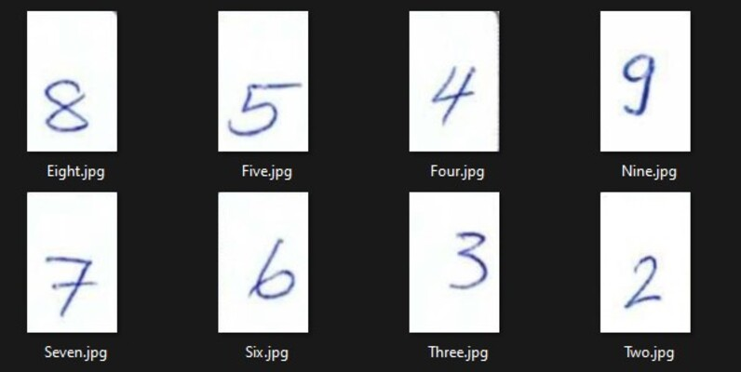
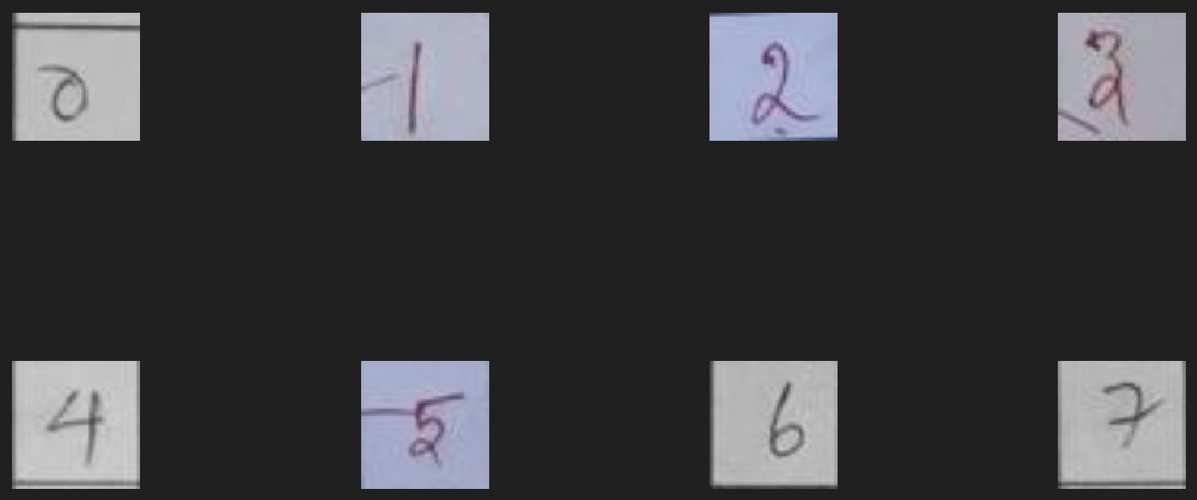
Work Done So Far
Used a library ‘img2table’ for detecting and extracting cells.
Created dataset using an online handwritten dataset & images from answer sheets.
Online Dataset Header Image
Answer Sheet Dataset Sample Images
Artificial Intelligence & Data Science Mini Project: ADD334 12th June 2023 13/20
Notes:
Done 3 works - cell extraction, dataset creation, and building a neural network.

Slide 30
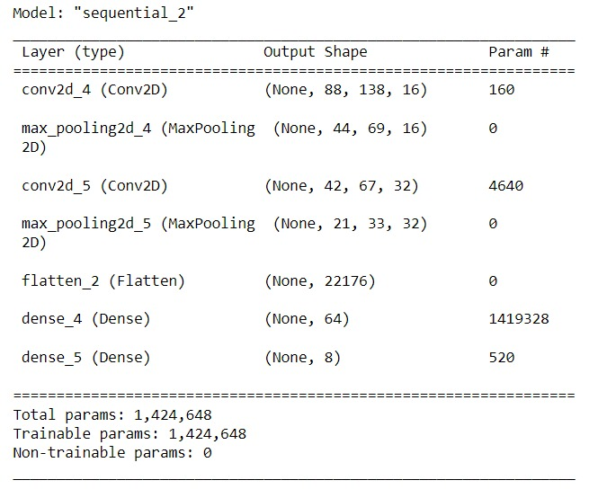
Custom OCR Model Summary
Artificial Intelligence & Data Science Mini Project: ADD334 12th June 2023 14/20

Slide 31
Conclusion
Ensure that the predictions are accurate need to improve the accuracy further.
need to integrate the table detection algorithm & a custom OCR model.
aim to reduce the time taken by teachers to do the mark data entry procedure.
Preliminary results has yielded great success but can still be improved.
Validation accuracy of CNN is 95.81%.
Artificial Intelligence & Data Science Mini Project: ADD334 14th March 2023 17/20

Slide 32
Data Description
Excluded
May be useful in future
Primary data are ‘Answer sheets of our college’, which are image data of A4 size
The data comes under ‘college documents’ domain
Initial data can be collected from our department, for more data variability, we could request it from other departments of our college itself.
Data can be compressed to file format like PDF for easy portability
Data size: Input data can have 5-10MB (PDF), and output data can have 4KB - 2MB (CSV)
Data may be unstructured and papers may be damaged or faded.

Slide 33
Outline
Introduction
Problem Statement
Application
Literature Survey
Block Diagram
Data Collection
Work Done So Far
Performance Evaluation
Work To Be Done
Conclusion
References
Artificial Intelligence & Data Science Mini Project: ADD334 12th June 2023 2/20

Slide 34
Work To Be Done
Collect more datasets
Analyze model performance using additional methods
Integrate custom OCR tool
Preprocess DataFrame
Physical equipment for holding the camera
Artificial Intelligence & Data Science Mini Project: ADD334 12th June 2023 16/20
Notes:
●More data means more learning
●Precison, recall etc..
●Now we’re using paddle ocr, remove paddle & integrate our custom ocr
●Remove unwanted rows & columns
●Phy equip for real time capturing, we get more aligned pictures

Slide 35
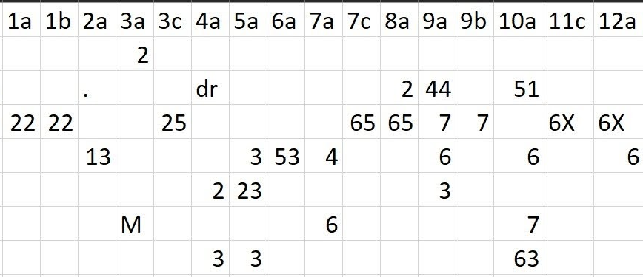
Mistakes in Paddle OCR predictions.
Created neural network for number detecting (Custom OCR tool).
Output of Paddle OCR tool
Artificial Intelligence & Data Science Mini Project: ADD334 12th June 2023 14/20
Notes:
●Convert values in image to digital text,
●we used easyOCR, PyTesseract & Paddle OCR
●Paddle gives a result, but predictions were poor
●So we planned to make a network

Slide 36
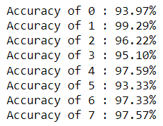


Performance Evaluation
Neural Network Accuracy
Time taken for Prediction
Prediction Accuracy
Artificial Intelligence & Data Science Mini Project: ADD334 12th June 2023 15/20

Slide 37
Research Scope and Objective
To detect decimal point marks during the OCR processing.
To clearly identify the digits properly to attain optimal results.
To train the model more to detect marks greater than 7 if the customer’s input is so.
Create a smaller device to encase the tool.
Objective: Create a tool to help ease the teacher’s efforts in data entry process, by implementing OCR techniques with the help of CNN.
Artificial Intelligence & Data Science Mini Project: ADD334 12th June 2023 9/25

Slide 38
Techniques
User interface created in Flask & HTML.
Real time capturing of the answer sheets.
img2table library for coordinate extraction.
Processing on built-in data structure (ordered dictionary) for speed.
Using custom trained OCR tool supported by a CNN architecture for classification.
Artificial Intelligence & Data Science Mini Project: ADD334 12th June 2023 15/25
Notes:
ANN Created, and presented as CNN.

Slide 39
Classification Report
Precision: How accurate the models are in predicting positive samples.
Recall: How effectively a model can identify positive samples.
F1-Score: The average of precision and recall, providing a balanced measure of a model's performance.
Artificial Intelligence & Data Science Mini Project: ADD334 12th June 2023 19/25

